Slide 1

Session 04
Introduction to ADO.NET
Data Classes

Slide 2
Review
Dialog box
Types of Dialog Boxes
System Defined Dialog Boxes
User Defined Dialog Boxes
Retrieving Information from a Dialog Box
MDI Application and Menus
Multiple Document Interface Applications
Menus
ToolStrip Control
StatusStrip Control

Slide 3
Introduction to .NET
ADO.NET Architecture
.NET Data Providers
Data Access Components

Slide 4
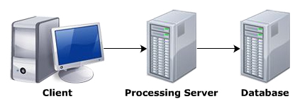
ADO.NET Architecture>>What is database?
A database is a collection of related records. The information in the database is stored in such a way that it is easier to access, manage, and update the data. Data from the database can be accessed using any one of the following architectures
Single - tier Architecture
Two - tier Architecture
Three - tier Architecture

Slide 5
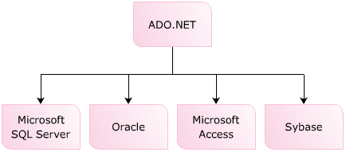
ADO.NET
ADO.NET is the data access technology, which allows you to access data residing in various data sources. ADO.NET is a part of the .NET Framework, which means that the technology can be used for all .NET- based application. ADO.NET supports disconnected data architecture. This means, that the connection to the data source is established only when it is required. ADO.NET uses XML to interact with the database

Slide 6
Features
Asynchronous Processing
Multiple Active Result Sets(MARS)
XML Data Support
Bulk Copy Operations
Batch Processing
Tracing
Connection Pooling Control

Slide 7
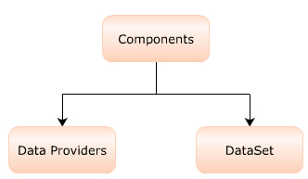
Data Access Architecture

Slide 8
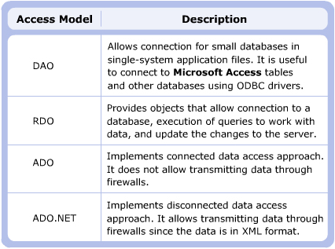
Different Data Access Models

Slide 9
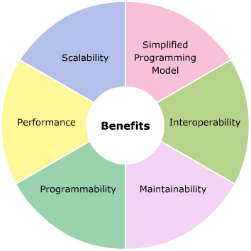
Benefits of ADO.NET

Slide 10
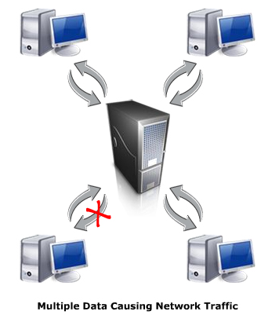
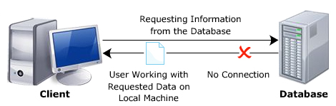
Connected and Disconnected
Disconnected Architecture
Connected Architecture

Slide 11
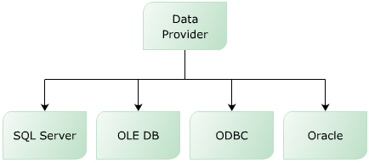
.NET Data Providers
Data Providers are used for providing and maintaining connection to the database. They are a set of related components that work together to provide data in an efficient manner.

Slide 12
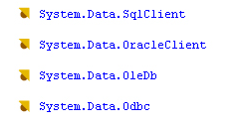
“System.Data” Namespace

Slide 13
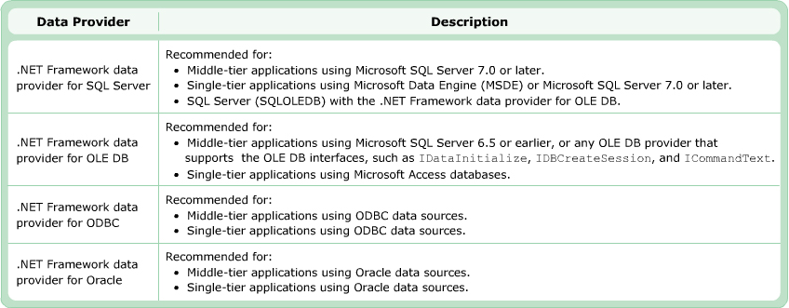
Choosing Data Provider

Slide 14
Data Access Components
DataSet
.NET Data Provider
DataTableCollection
Connection
DataAdapter
DataTable
Transaction
SelectCommand
DataRowCollection
Command
InsertCommand
DataColumnCollection
Parameters
UpdateCommand
ConstraintCollection
DataReader
DeleteCommand
DataRelationCollection
Database
XML

Slide 15
Data Access Components…
Connection object
Command object
DataAdapter object
DataReader object
DataSet object
DataProviders

Slide 16
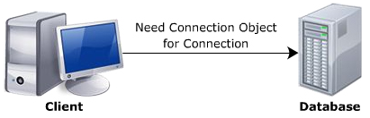
“Connection” Object
The Connection object allows you t create a connection between your application and the database. It stores information that is required to establish the connection.
Classes to establish the connection to SQL Server and OLEDB data sources.
SqlConnection Class
OleDbConnection class

Slide 17
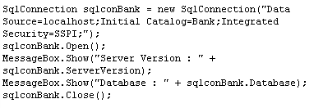
Establish the connection
SQL Server

Slide 18
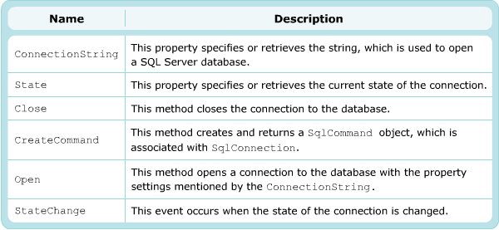
Common properties, method and events

Slide 19
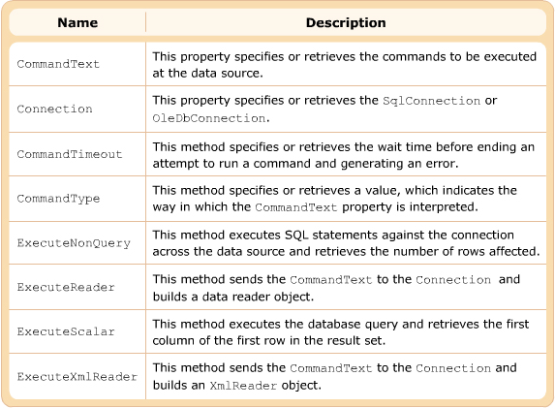
“Command” Object
The Command object enables you to execute a specific command against a data source, The Command object stores and executes SQL commands across a data connection. It can be used to execute SQL such as UPDATE, DELETE, INSERT, or SELECT and call to a stored procedure
……………..
string sqlinsert=“insert into employee values(1,N’Jennyfer’,’cali’,’abc@gmail.com’)”;
SqlCommand cmd=new SqlCommand(sqlinsert,Con);
cmd.ExecuteNonQuery();
………………

Slide 20
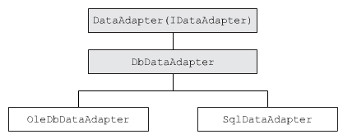
“DataAdapter” Object
The DataSet object stores data from data source. It gets data through data adapters. The data adapter serves as a link between a DataSet and a data source for retrieving and saving data.

Slide 21
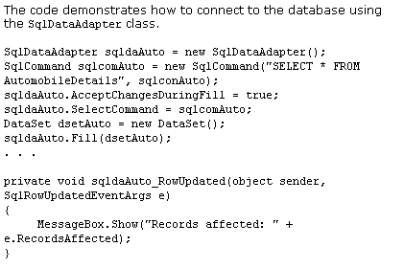
Example

Slide 22
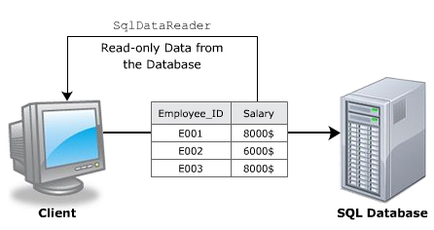
“SqlDataReader” Class
The SqlDataReader class is used to data from a SQL Server database in a sequential manner. It retrieves a forward-only and read-only stream of data when a connection to the database is established.

Slide 23
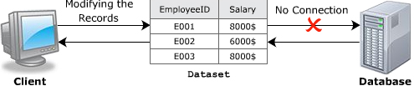
“DataSet”
A DataSet object is a representation of database objects in the cached memory. The database objects include relational tables and constraint. A DataSet object indirectly interacts with the data source. It can only hold data retrieved from the data source.
Features of datasets
Working with Disconnected Data
Working with Hierarchical Data
Caching Changes
Supporting XML Integration
Implementing Uniform Functionality

Slide 24
Types of DataSet
DataSet
Typed DataSet
UnTyped DataSet

Slide 25
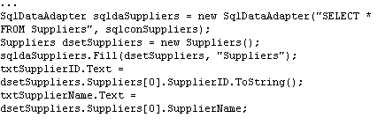
Typed DataSet
A typed DataSet is a class derived from the DataSet class and inherits all the properties, methods, and events of the DataSet class. When a typed DataSet is created, three derived classes, namely DataTable, DataRow, and DataRowChangeEvent are generated for each table in the DataSet. These classes have specific schema, properties, and methods for the associated tables. The typed DataSet object can catch any type mismatch errors at compile-time.

Slide 26
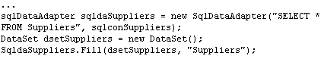
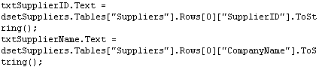
UnTyped DataSet
An untyped dataset does not have a buit-in schema. In this dataset, the tables and columns are represented as a collection of data.

Slide 27
Fetching XML Data Using Datasets
Example
DataSet Ds=new DataSet();
Ds.ReadXml(“author.xml”);

Slide 28
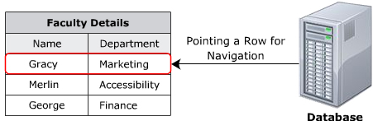
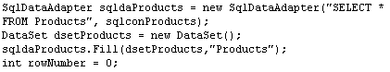
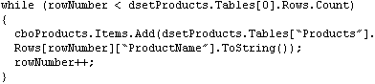
Navigating Records

Slide 29
“DataTable” Class
A DataTable class represents a table in the Dataset. It is used to store data from a data source. It contains a set of rows and columns to organize data in a tabular format. It is widely used in the disconnected enviroment. DataTable object can be implemented for any database. It can store the result of SQL queries, which can be later accessed or manipulated using the DataRow and DataColumn objects.
The DataTable contains constraints objects that ensure the data integrity in the related tables

Slide 30
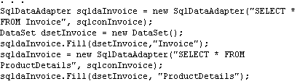
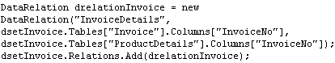
“DataRelation” Class
The DataRelation class is used to relate two tables through DataColumn objects. For adding relation between tables, you must specify the common column that exists in both the tables.

Slide 31
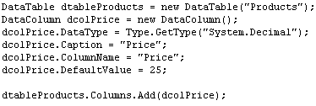
“DataColumn” Class
The DataColumn class used to for creating a schema for a particular column. It is the basic element for DataTable. The schema is used to define the data type and constraints. You can add DataColumn objects to the DataTableCollection to create the schema of the DataTable

Slide 32
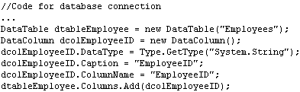
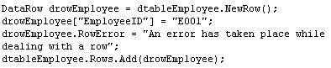
“DataRow” Class
The DataRow class represents a row in a DataTable. The object of the class is a basic element of the DataTable. The class is used to insert, update, and delete values in the DataTable.

Slide 33
Summary and Workshop
ADO.NET Architecture
.NET Data Providers
Data Access Components
Connection object
Command object
DataAdapter object
DataReader object
DataSet object
DataProviders

Slide 34

THANKS FOR WATCHING !

